Slide 1

Enter the mixed reality world
Sulaeman Santoso

Slide 2
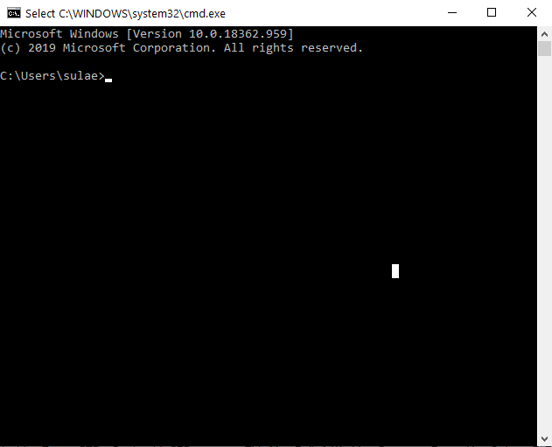


Name : Sulaeman Santoso
Affiliation : MCU
YouTube Channel
https://www.youtube.com/c/sulaemansantoso

Slide 3

What is mixed reality ?
VR/AR
Notes:
https://medium.com/@marknb00/what-is-mixed-reality-60e5cc284330

Slide 4


Slide 5



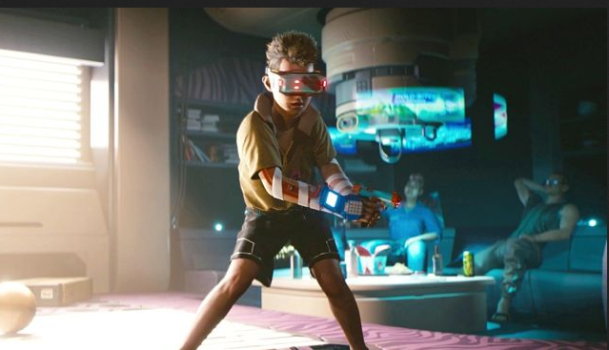

Slide 6
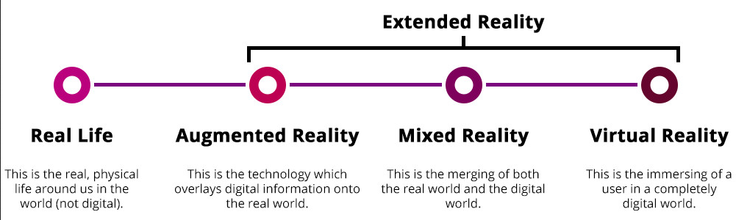
XR – extended reality
Xtended Reality
Includes VR, AR, MR
Notes:
https://www.tvrlp.com/ultimate-extended-reality-glossary/

Slide 7
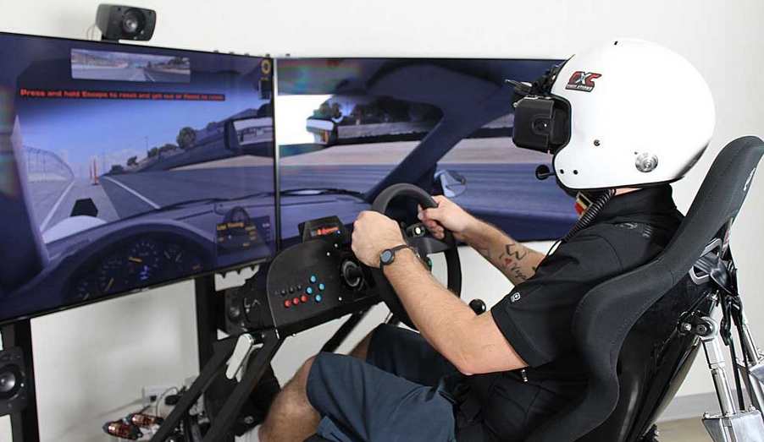
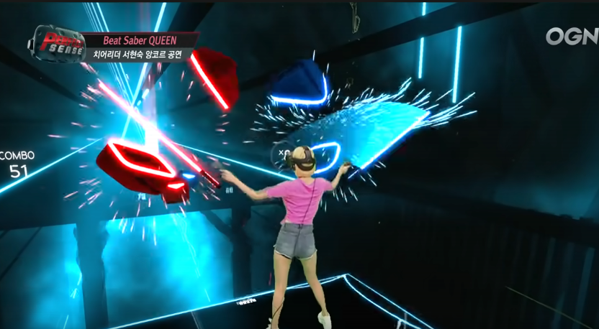
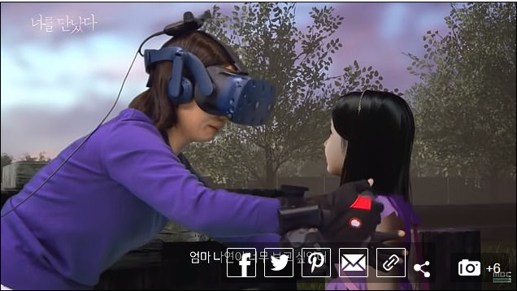
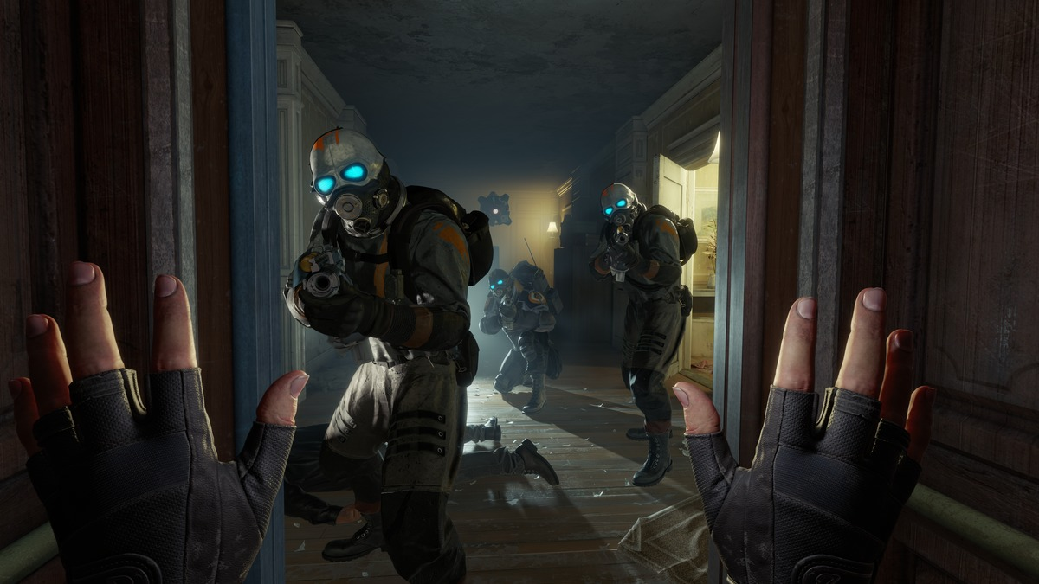
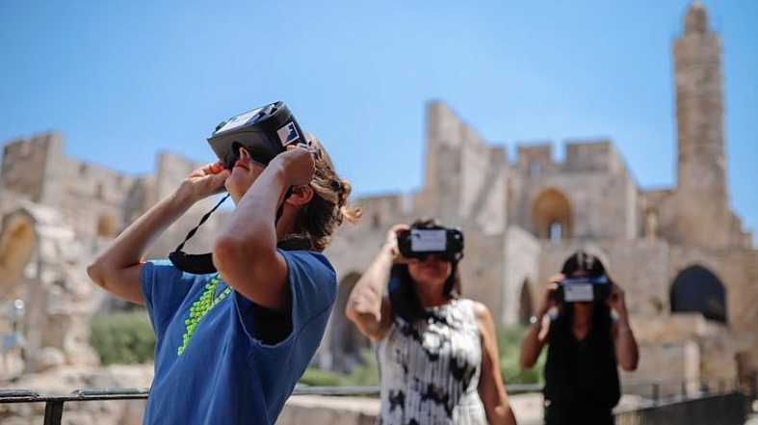
VR in our lives
Games
Simulation
Training
Treatment
Notes:
https://www.dailymail.co.uk/sciencetech/article-7988645/TV-uses-virtual-reality-reunite-mother-7-year-old-daughter-died-2016.html
https://www.pcworld.com/article/3454837/half-life-alyx-vr-prequel-2020-valve-index-free.html

Slide 8
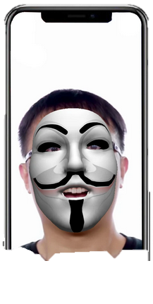
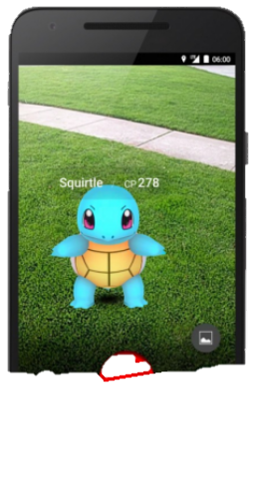
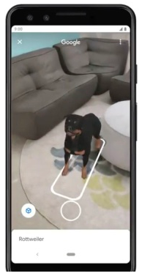
AR in our lives
Pokemon GO
Spark AR
Google animal
Etc
Notes:
https://www.fiverr.com/dextro432/spark-ar-instagram-filter

Slide 9

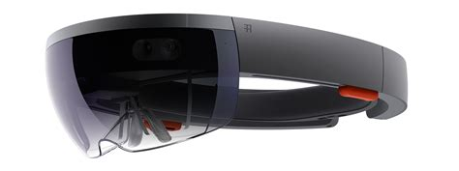
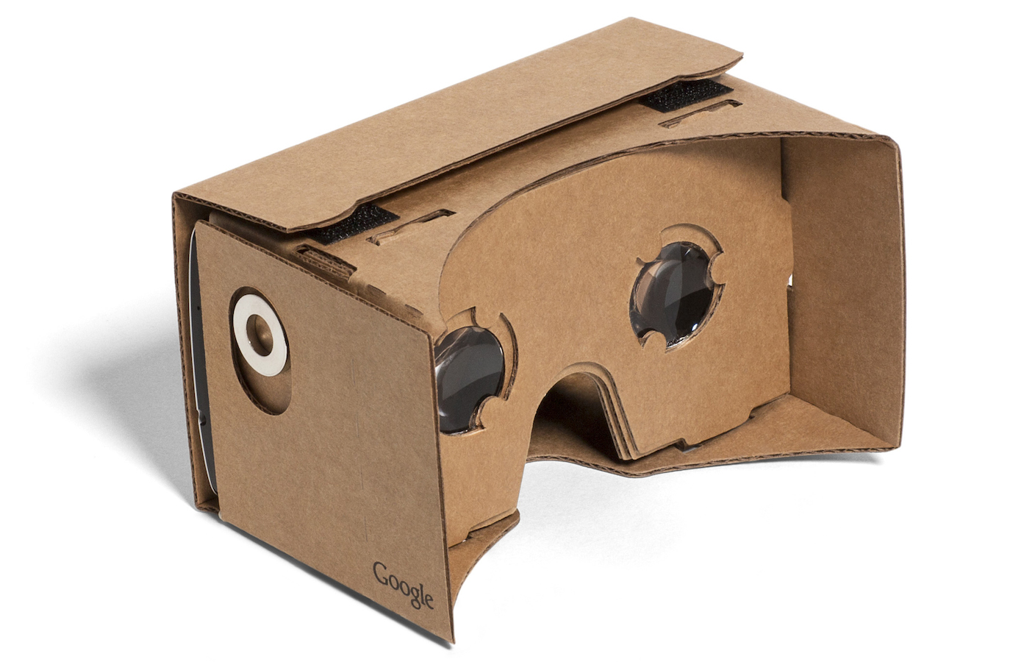
Emerging device

Slide 10
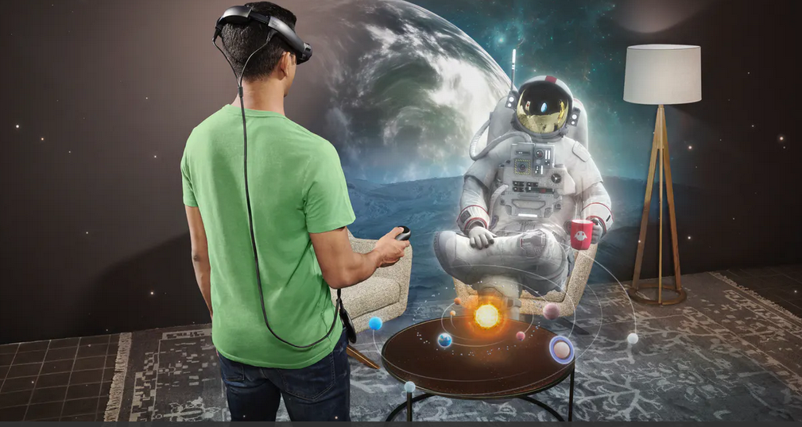

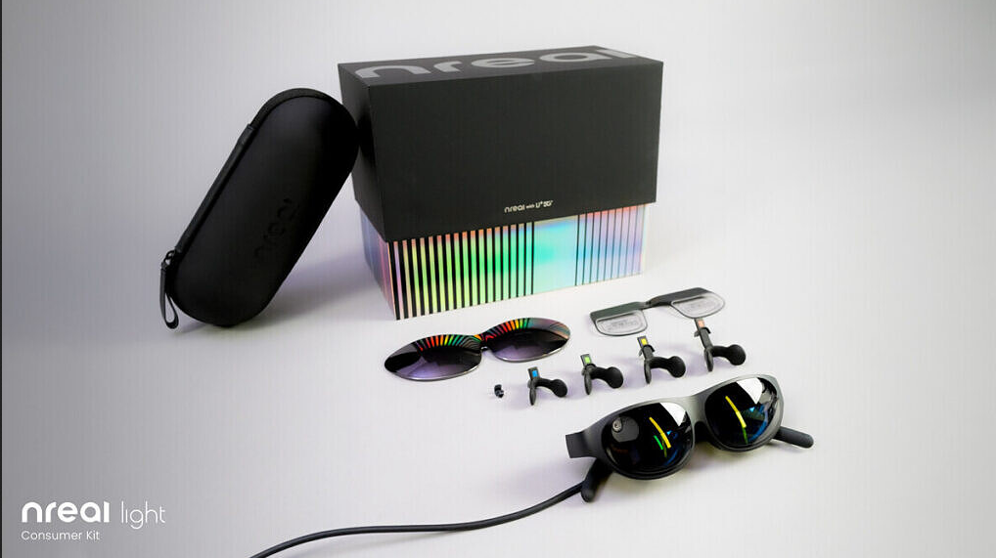

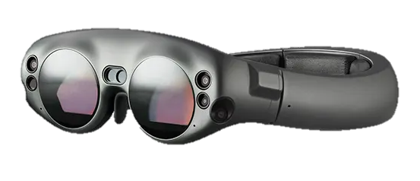

Magic Leap

Slide 11
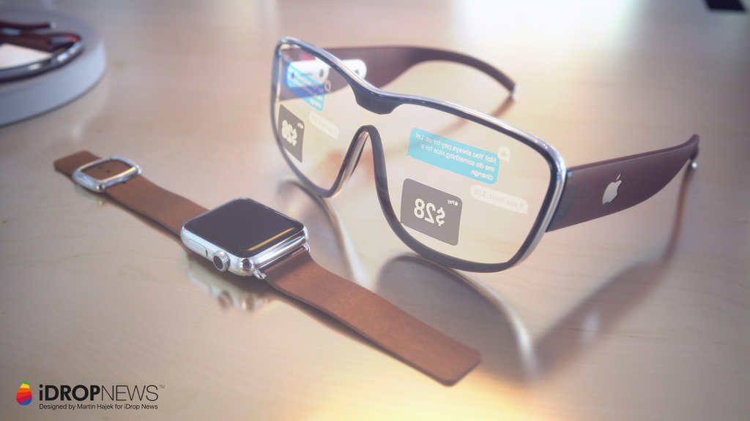

Apple Glass (2023 ?)
Notes:
https://medium.com/augment-the-world/apples-ar-glasses-will-replace-your-tv-f1c055abf10f

Slide 12

The world is evolving.. Don’t stay behind

Slide 13







Developing VR/AR
Is it hard ?
There are plenty of road to choose from
Using game Engine (Unity, Unreal)
Using Application such as Spark AR / ZAPPAR
Use Frameworks, AFrame, THREEJS, ARKIT AR CORE

Slide 14
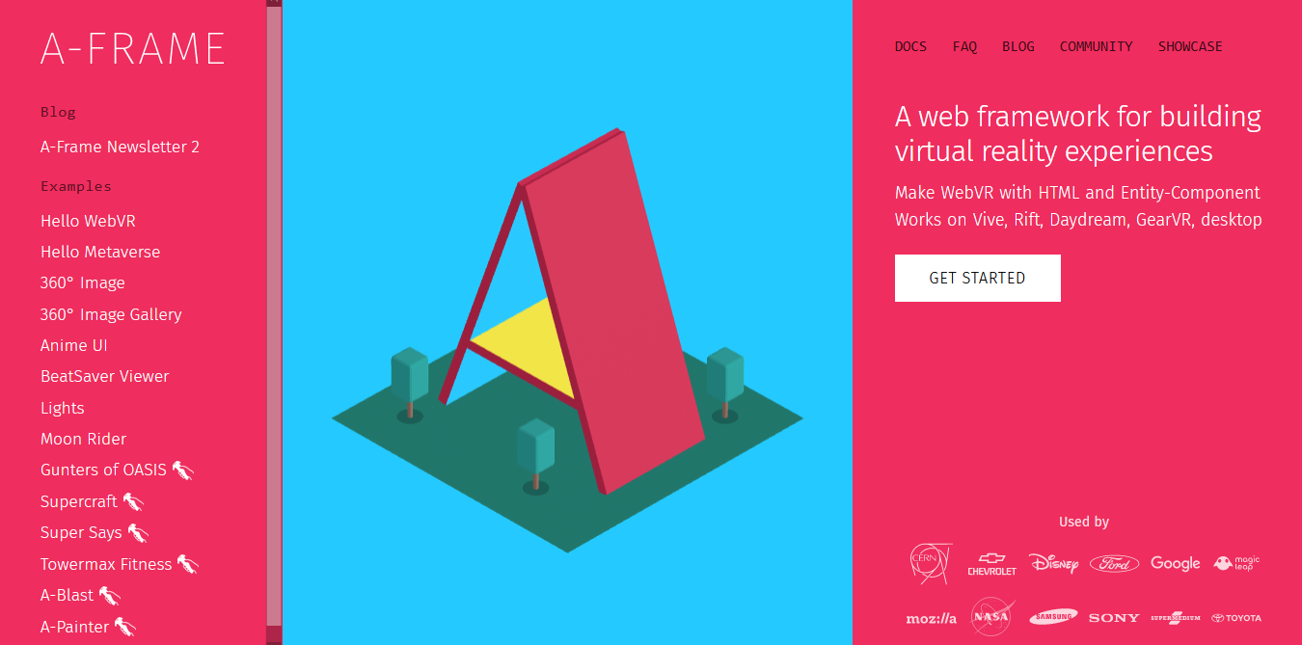

Introducing AFRAME
https://aframe.io/

Slide 15
Why AFRAME
Its webGL
Runs on anything with a javascript enabled browser (almost)
Its javascript
No need to learn another language, you can use any javascript library you have
Its simple,
you don’t have to install anything, easy to understand
Its light
you don’t need a powerful PC

Slide 16

Demo AFRAME

Slide 17

More on AFRAME
Checkout my youtube channel XD
https://www.youtube.com/c/sulaemansantoso

